Slide 1
UNT Guidelines for Institutional Effectiveness (IE) Reporting
Essentials
Timeline
Reporting in the Improve database
Contact Info
Office of University Accreditation

Slide 2
Institutional Effectiveness (IE)
Institutional Effectiveness is the systematic and ongoing process of identifying expected outcomes, assessing the extent to which the outcomes are achieved, and providing evidence of seeking improvement based on analysis of the results. This process involves all programs and services at all levels at UNT.
In general, UNT focuses on two major categories of expected outcomes:
Academic Expected Outcomes (i.e. Student Learning Outcomes);
Non-Academic Expected Outcomes (i.e. Administrative Outcomes).

Slide 3
UNT’s Institutional Effectiveness (IE) plans:
All degree programs
Graduate certificates
Administrative offices
Student service areas
General education courses (The Core)*
_________
400+ IE plans across campus
600+ Nuventive Improve users
*See next slide

Slide 4
The following guidelines are only for the IE plans concerning academic degree programs, graduate certificates, student services and administrative offices.
* Separate guidelines are available for faculty entering data for courses in The Core. Contact core@unt.edu for more information.
* Separate guidelines are available for Centers & Institutes. Contact elizabeth.vogt@unt.edu for details.

Slide 5
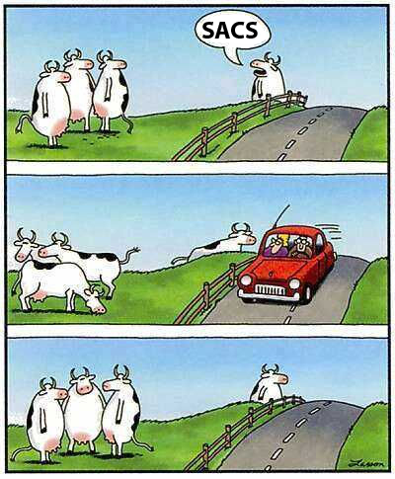
Components of Effectiveness Plans
Five different components of effectiveness plans in Improve:
Expected outcomes (SLOs/AOs)
Assessment methods
Criterion for success (target)
Data results/analysis with evidence
Use of Results & Status of Action for seeking improvement
This is NOT our approach!

Slide 6
Diet Analogy of Effectiveness
Outcome Statement
Set weight goal
Assessment Method & Criterion Statement
Get on scale daily
Results & Evidence
Write a summary of results over period of time
Use of Results
State strategies to improve weekly progress (reduce calories or carbs, increase activity, etc.)
Review healthy weight ranges by height/age
Record results in log
Set weekly goal (-2 lbs)
Compare against goal
Log is your evidence of assessment
Provide an update on how latest strategies worked or didn't work

Slide 7
Department / Division responsibilities
Developing program plans is a collaborative effort
Academic Plans should be reflective of the collective goals of the program faculty for the degree
Administrative Plans should reflect the collective goals of the administrators
The collection, interpretation, and use of student learning evidence is a collective endeavor, and is not viewed as the sole responsibility of a single position. (SACSCOC.ORG)
Maintenance of your plan is vitally important
At least two faculty members (for academic plans) should be responsible for maintaining each plan
At least two FT staff should be responsible for maintaining each administrative plan
Continuity in assigned faculty/staff is vital for a successful plan.
The plan & results should be regularly communicated with the whole department.

Slide 8
IE Cycle @ UNT
All Results, Evidence, Use of Results and Status of Improvement Actions information from the previous Academic Year are due by October 15th.
Completed 2021-22 IE plans are due October 15, 2022
for Fall 2021, Spring 2022 & Summer 2022 data.
Any new outcomes and assessment methods for the current academic year must be entered by October 15th.
Plan Audits (for quantity, not quality) take place in October.
Peer Committees Review the IE reports (for quality) beginning in November and continuing through April. Scores distributed by email.
Workshops and consultations continue as needed through June to improve scores..

Slide 9
Recent Changes
= Expanded help for definitions and instructions
To improve clarity, some terminology has changed in Institutional Effectiveness Plans:
Column 4
Recommendations has changed to “Use of Results for Improvement”
Action planned next (formerly called recommendations) = improvement actions planned the subsequent cycle based on analysis of the results
Status of action (formerly called follow-up) = status of improvement actions entered last year (12 month status update)

Slide 10
Recent Changes
Multiple modes of program delivery
Starting with the 2018-19 review cycle, academic programs taught through more than one delivery mode lost peer review points if data were not disaggregated by mode. Disaggregating data by mode is not a new expectation. However, 2018-19 is the first year points were deducted for failing to do so.
There is an expectation that analysis and improvements consider performance gaps between modes.
The Peer Review Rubric addresses the review of programs with multiple modes of delivery.

Slide 11
Recent Changes
Methods of Assessment
As a best practice, we recommend that each outcome have two or more methods of assessment. Multiple methods of assessment provide a more comprehensive analysis of the extent outcomes are being achieved.
Before 2019-2020 peer review cycle, plans lost 5 points for each outcome that did not have at least 2 methods.
Starting with 2019-2020 peer review cycle, outcomes with more than one method of assessment will receive a 5 point bonus. No points will be deducted for outcomes with a single method of assessment.
The peer review rubric has been updated for this change.

Slide 12
Peer Review
UNT Peer Reviewers only review your four-column report and its attachments.
Your plan is scored against the UNT IE Rubric. Scores range from 0-100. Plans must score 70 or above to be compliant.
Peer Reviewers review the first 3 active outcomes listed in your 4-column report.
Plans that do not have results entered for the year are not scored.
The average of all 3 outcomes becomes the plan’s score.

Slide 13
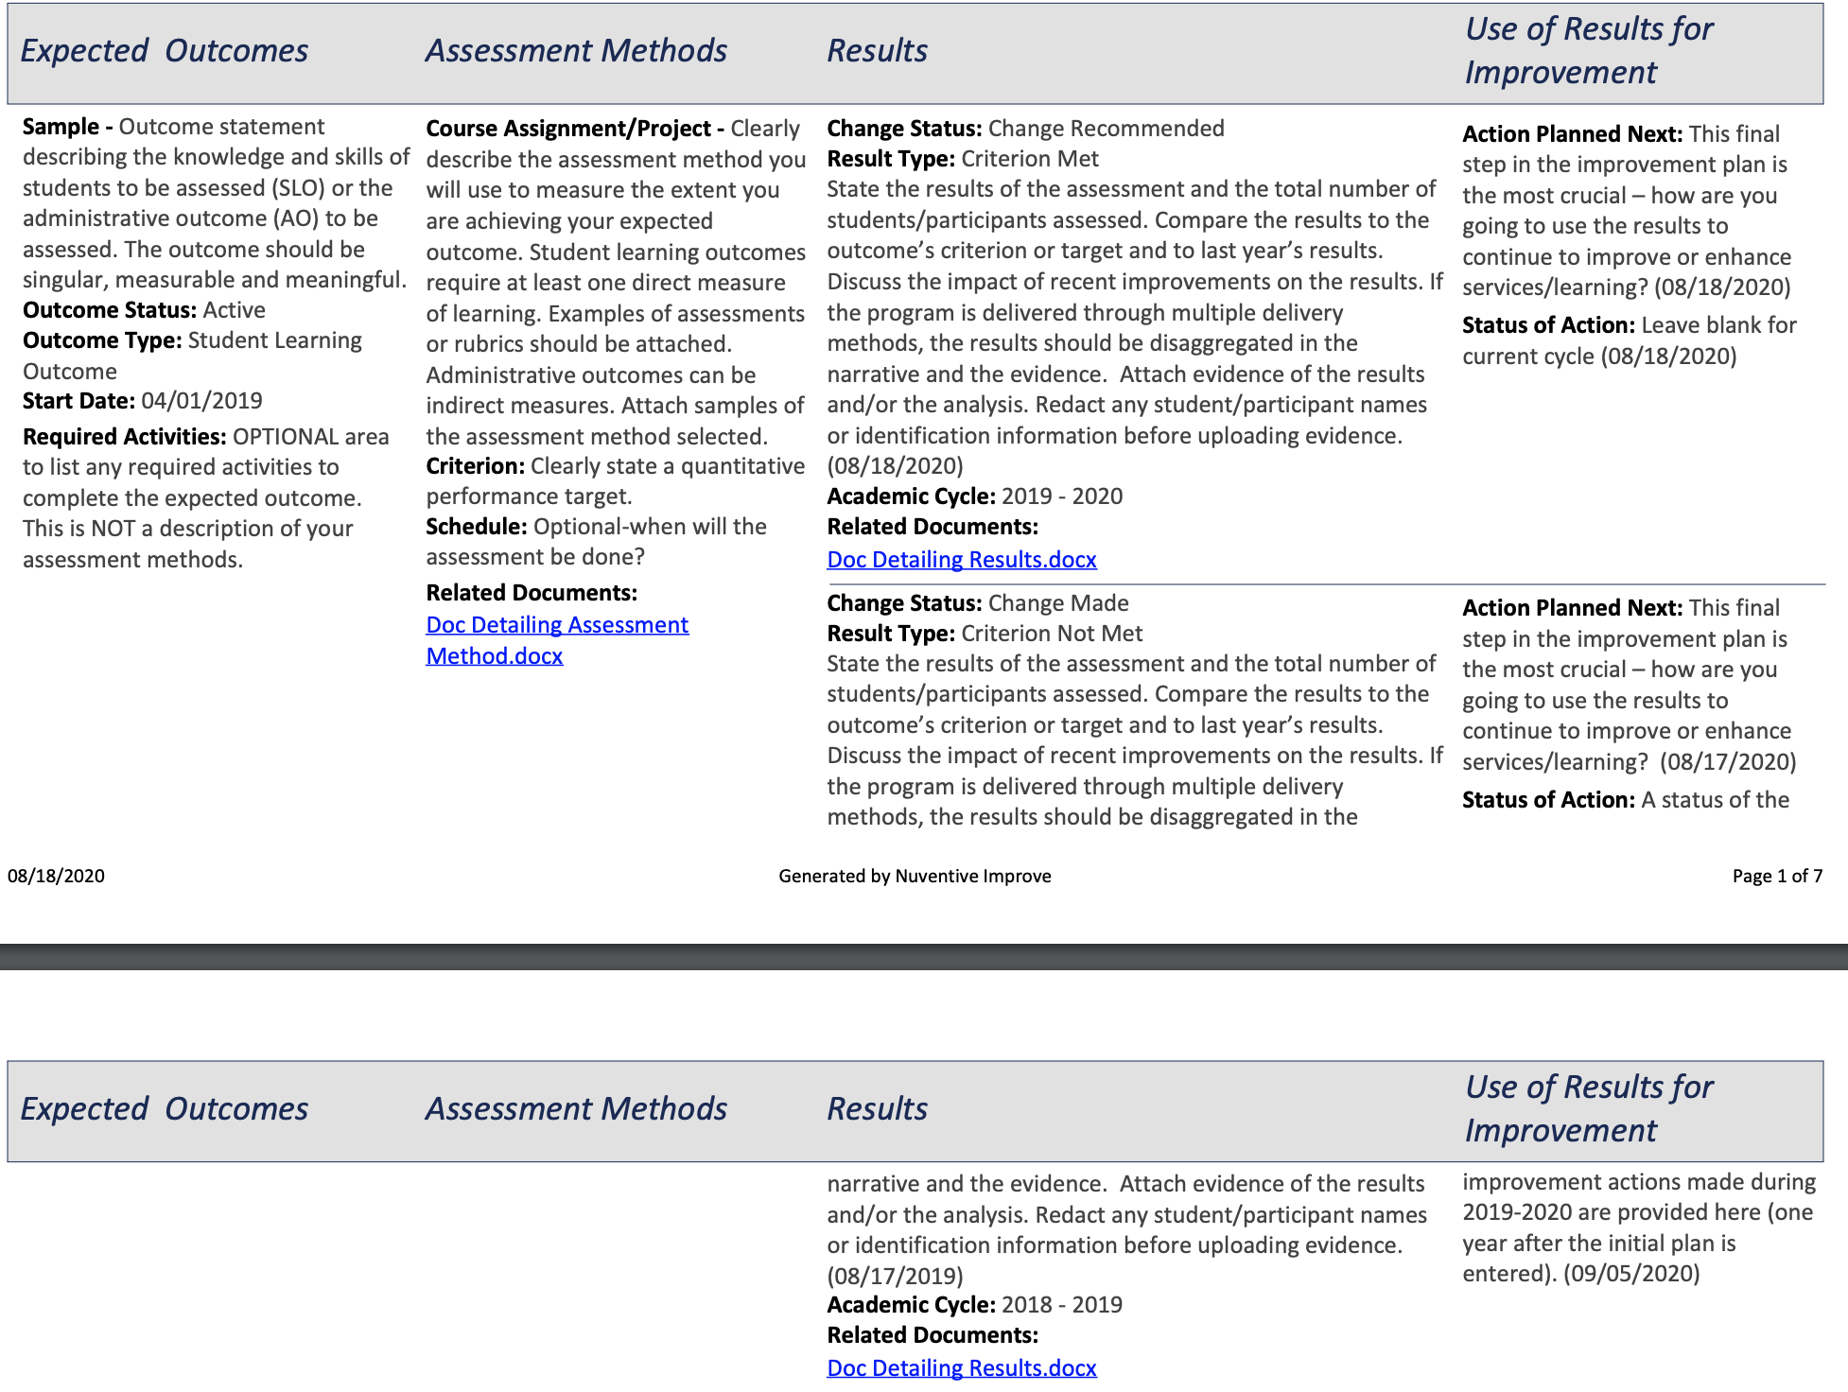
RUBRIC SCORING by COLUMN
10 points
30 points
20 points
40 points
=100 points

Slide 14
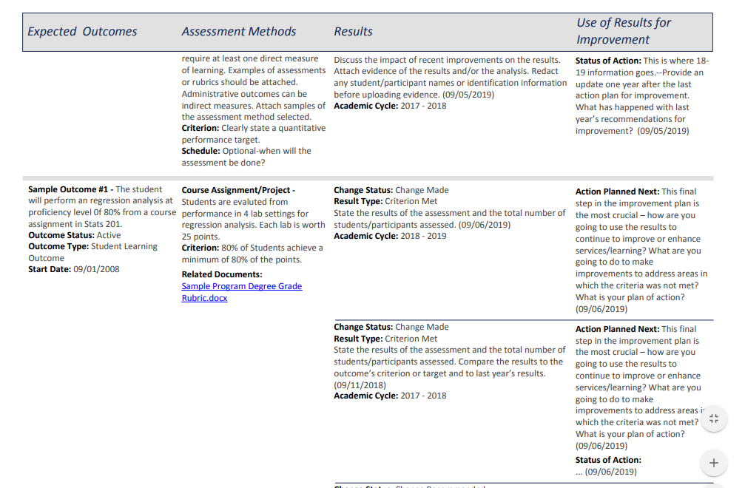
Don’t lose points, complete missing information in your plan
Upload your documents showing your results
Follow up on previous year’s planned improvements

Slide 15
Common Reasons for low scores (< 70 points):
Assessment method or example not attached
Evidence of results not attached
Outcome active for more than a year with no results
Active outcome with results entered and no improvement actions made
Active outcome with use of results from the prior year that have no status of action information
Criterion statement is not quantitative

Slide 16
Here is a fully, completed plan:
Assessment artifacts attached
Evidence of results and analysis attached

Slide 17
Make your outcomes…..
Outcomes statements are the foundation of institutional effectiveness plans.
MEANINGFUL
& MEASUREABLE

Slide 18
Expected Outcomes
Consists of Student Learning Outcomes (SLOs)
Describe the abilities, skills, knowledge that you want students in your program to acquire
Each SLO must be singular and measurable
Consists of Administrative Outcomes (AOs)
Describe the effectiveness of unit actions/activities
Each AO must be singular and measurable
Must have at least 3 SLO/AOs and should not have more than a total of 5 active SLO/AOs
Peer review teams review a maximum of 3 SLO/AOs

Slide 19
Writing Student Learning Outcomes
The key to Student Learning Outcomes is MEASURABILITY.
Use active verbs that describe an observable behavior
Behaviors that can be measured
Use compound statements judiciously
Words to avoid in an SLO……..Students will:
“understand” – an internal process that can’t be easily measured
“value or appreciate” – tricky to measure
“become familiar” – how do you measure familiarity
“learn/think about…” – not observable
“become aware of…”
“have ability to…” – Doesn’t measure achievement or demonstrate a skill (ability vs. achievement are different)

Slide 20
Other Verbs to Consider for SLOs
Remember Understand Apply Analyze Evaluate Create
State Classify Calculate Combine Appraise Arrange
Define Describe Construct Figure Argue Assemble
Locate Identify Estimate Find Assess Compose
Recall Indicate Illustrate Sketch Defend Create
Recite Organize Interpret Solve Estimate Design
Quote Interpret Appraise Predict Judge Devise
Label Illustrate Contrast Change Predict Formulate
Identify Reorganize Criticize Survey Qualify Invent
List Translate Diagnose Compare Rate Manage
Report Identify Diagram Support Modify
Summarize Classify Examine Critique Organize
Transform Test Recommend Plan
Discuss Modify Prepare
Explain Produce
Defend Propose
Compare Develop
Construct
From: The Eberly Center for Teaching Excellence, Carnegie Mellon University

Slide 21
Things to Keep in Mind:
If your outcomes are assessed in classes that are offered in more than one mode (internet, offsite location, face-to-face, etc.), disaggregate your data and compare attainment.
If a degree program can be completed by more than one mode, attainment of student learning outcomes must be compared by mode.
In addition to outcomes, syllabi should be comparable. For example:
a course should have the same outcomes/objectives regardless of mode/section
assessment methods should be similar across modes/sections so data is comparable
Administrative units should use comparison information if services are offered by more than one mode. (i.e., main campus, UNT@Frisco)

Slide 22
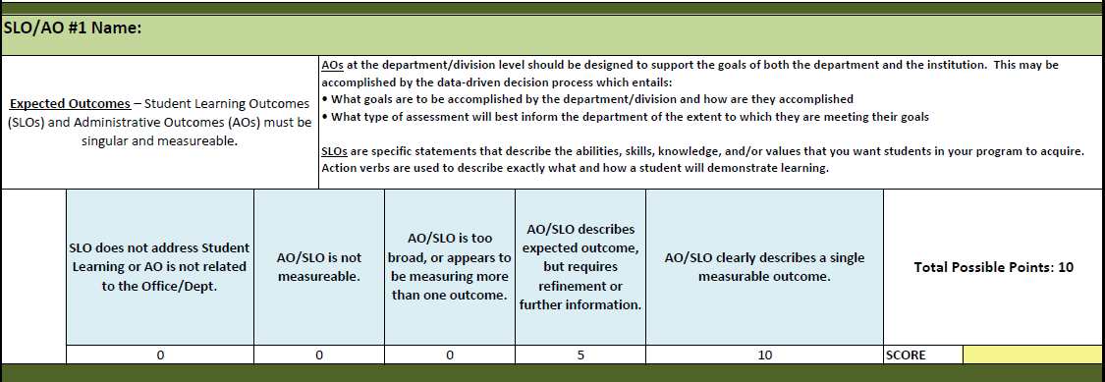
Rubric: Expected Outcomes

Slide 23
Assessment Methods
SLOs must be assessed with at least one direct measure:
How students show you what they have learned?
Assess the extent to which it achieves these outcomes
Direct measures include: exams, portfolio assessments, capstone projects, case studies, etc.
Indirect measures are based on attitudes or opinions
Course grades are not acceptable measures of assessment for SLOs
Documentation of the measure must be attached (available to review)
Performing arts may be more comfortable using qualitative data

Slide 24
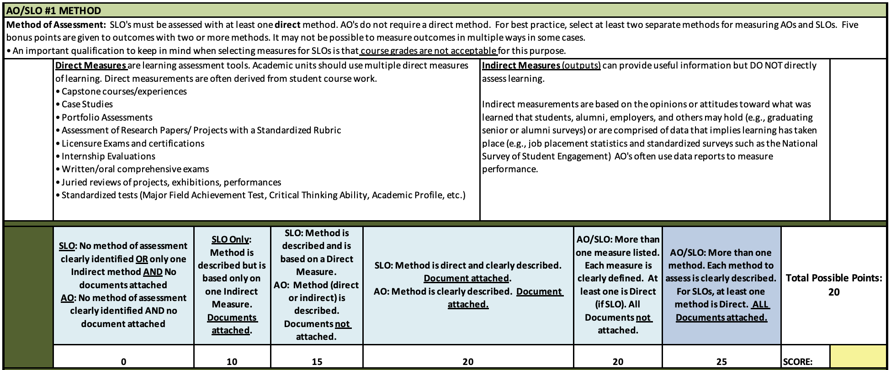
Rubric: Method of Assessment

Slide 25
Criterion (Performance target)
Indicates what performance level is acceptable for each method of measuring an SLO/AO
Should be prepared to explain why the criterion is set at a particular level, especially if the level is less than 70%
The criterion should be stated as a:
Quantitative target/goal
Specified percentage of students/clients attaining a given SLO/AO;
Exam/Quiz/Knowledge and Skills Assessment scores; or
Some other specific obtained value

Slide 26
Rubric: Criterion

Slide 27
Results
Findings from collected data:
Indicate how the findings compare with the expectation established by the criterion, and compare to previous years
Includes the percentage of students meeting the criterion AND the total number of students in the assessment. If a sample was used, explain the sampling methodology.
For AO surveys, list the number of participants.
Data must be collected and analyzed systematically:
Results must be entered annually
Evidence or documentation of analysis should be provided
Artifacts of assessment
Discuss how improvements are impacting results
Disaggregate and discuss data by delivery mode (programs with multiple delivery modes)

Slide 28
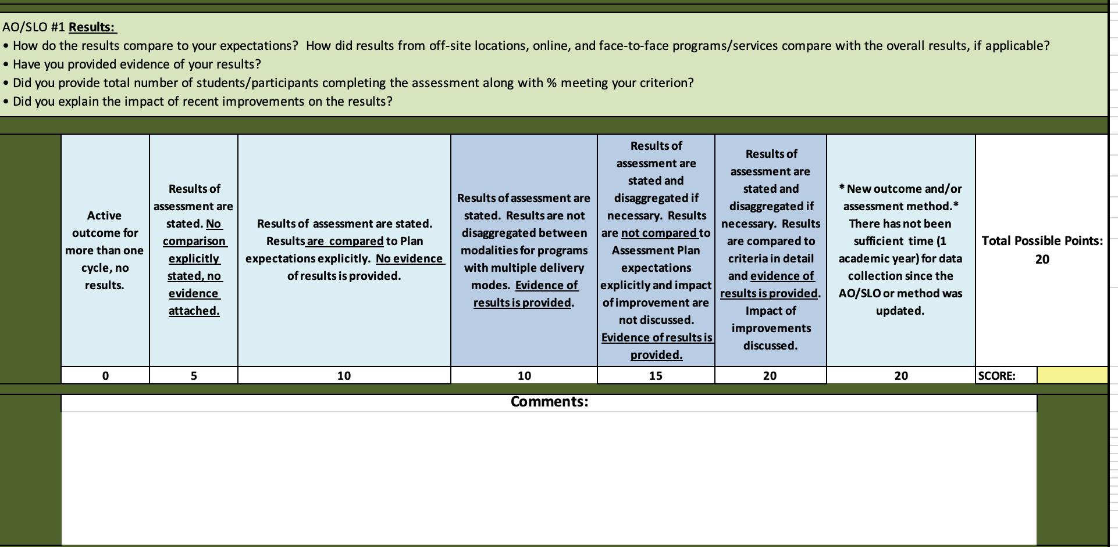
Rubric: Results

Slide 29
Use of Results & Status of Action
(formerly Recommendations & Follow-up)
Use of Results for Improvement: An action plan that indicates how results will be used to improve student learning and program quality:
What changes will be made next cycle if students did not meet the criterion?
If the criterion was met, what might be done to continue to foster improvement in the next cycle?
If the criterion is consistently met, should the standards be adjusted or should new SLOs/AOs be introduced?
Provides evidence of seeking improvement based on analysis of the results?
Status of Action: What happened with last year’s recommendations? Was the improvement plan implemented?

Slide 30
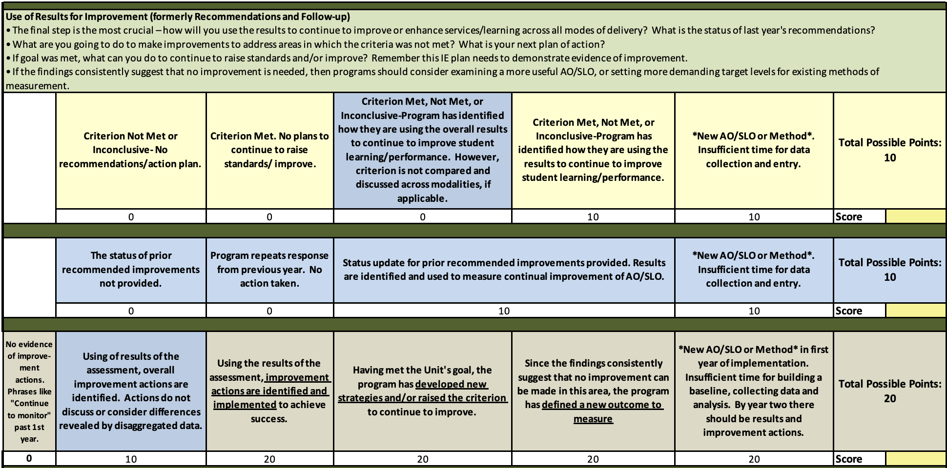
Rubric: Use of Results for Improvement

Slide 31
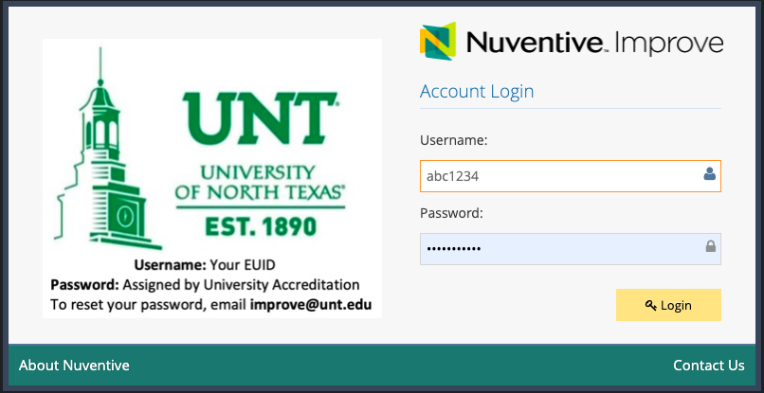
Accessing Improve
https://unt.improve.nuventive.com
For Username, enter your EUID
Enter your password (initially set to meangreen)
Please note: Your Improve password is separate from your UNT password. You are able to change your password in the Improve system.

Slide 32
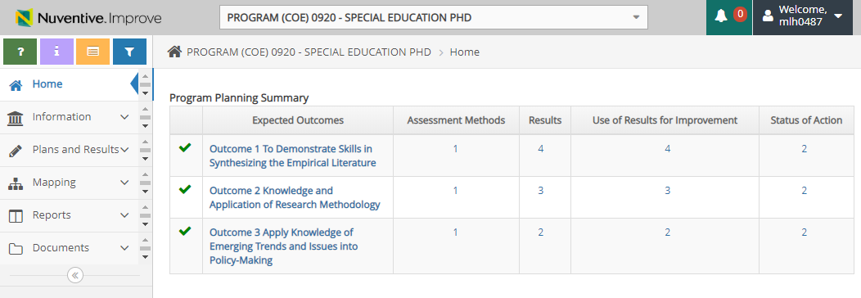
Improve Home Page
Access your plan(s)

Slide 33
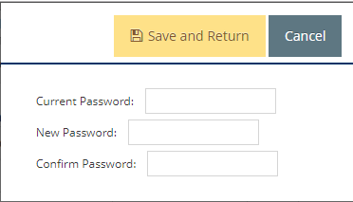
How to Change Your Password
Don’t forget to save your changes.

Slide 34
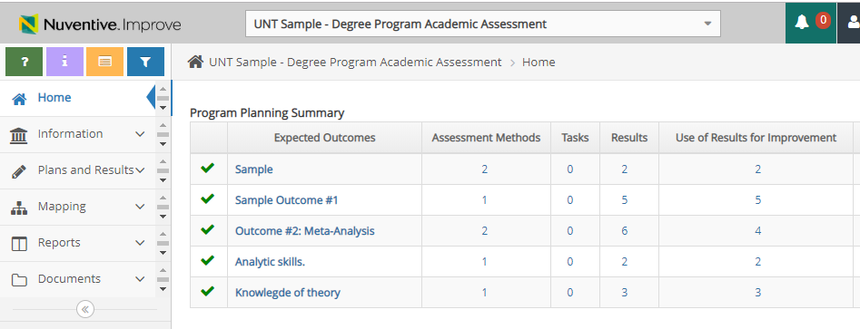
Improve Home page
1. Select the unit you want to work with
2. Click on the side tabs to navigate the system.

Slide 35
Helpful Hint: First and Last Step
Run a 4-column report at the beginning and end of your work in your plan.
The report reveals areas that need attention
When your plan is complete for the year, save a copy on your desktop & in the Document Repository for your plan (in case anything is deleted unintentionally in Improve).

Slide 36
Running a 4-Column Report
Select Reports from the side bar.
Click on Standard Reports.
Select Four Column Improvement Report

Slide 37
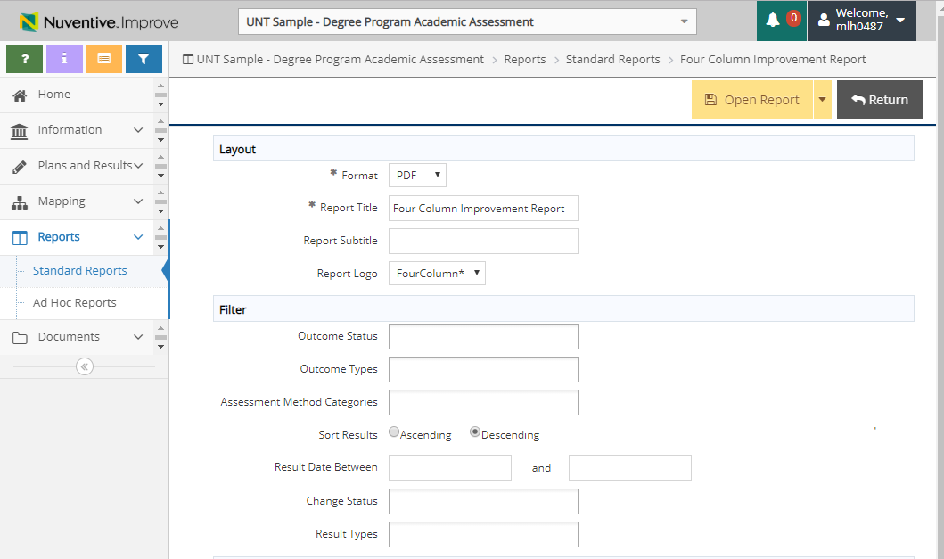
Select Open Report from the top right of the page
You can filter out completed/inactive outcomes from your report to reduce page length. This helps you focus on active outcomes.

Slide 38
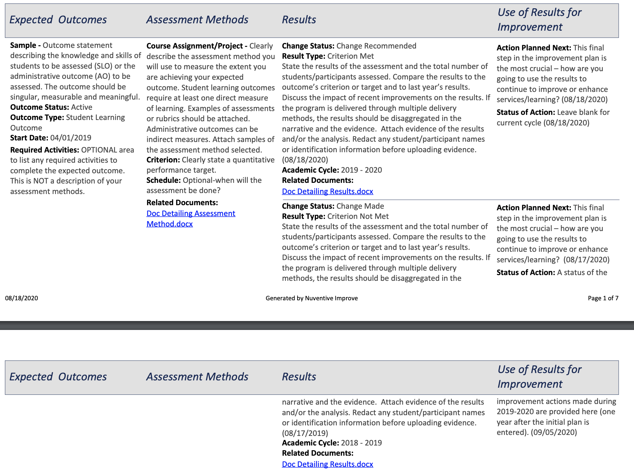
What pieces are incomplete?
This is an active outcome with the method attached. There are several years of results. All results have evidence attached.
Make sure your plan has a Status of Action of last year’s improvement plan.
Look to see if results have been entered for the academic year and results attached.

Slide 39
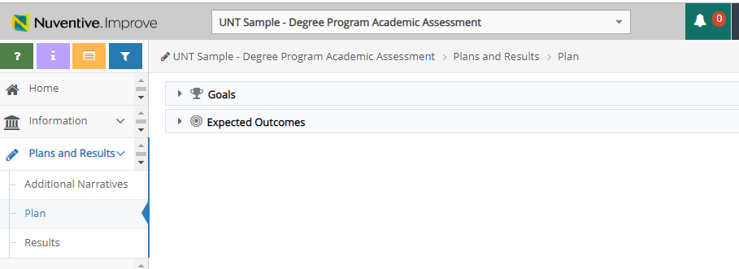
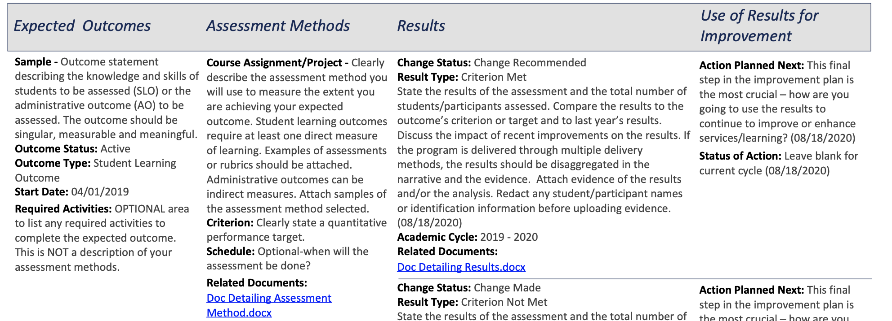
How do I update information in my 4-column report?
Update columns 1 & 2 under the “Plan” option
Update columns 3 & 4 under the “Results” option
1
2
3
4

Slide 40
How to update:
Column 1 – Outcomes

Slide 41
Adding or editing outcomes
1. Select Plans and Results 2. Click on Plan 3. Click on the arrow next to Expected outcomes to expand the selection
Column 1 – Outcomes

Slide 42
Outcomes
Use the “+” sign to add new outcomes or select the pen/paper logo next to the outcome you wish to edit.
Column 1 – Outcomes

Slide 43
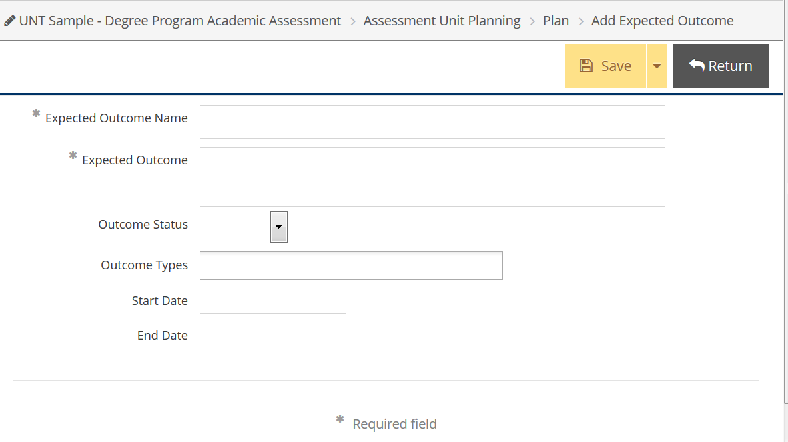
New Expected Outcomes
Insert a short name for the Outcome
Paste or write concise, singular outcome
For Outcome Status:
The selection of Outcome Status: Active indicates that the outcome is being actively monitored for the time period identified in the schedule. Usually no more than 5 outcomes per unit plan are active for a given year.
Inactive indicates that the outcome is defined and waiting to be monitored in the future.
Complete indicates that the outcome has been monitored and will not be monitored again.
Don’t forget to save your changes and return
Make a selection for Outcome Type. Academic programs generally look at Student Learning Outcomes while Department and Administrative Units generally look at Administrative Outcomes.
Enter a start date for assessment
Leave the end date blank until assessment of the outcome is complete and will not be assessed again.
Leave end date blank while active
Column 1 – Outcomes

Slide 44
Editing Existing Outcomes
If you need to refine or further specify an existing outcome, Click on the (#1) Plan tab, find the particular expected outcome, and select (#2) “Edit icon” for the outcome you want to edit.
#2
#1
Column 1 – Outcomes

Slide 45
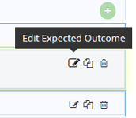
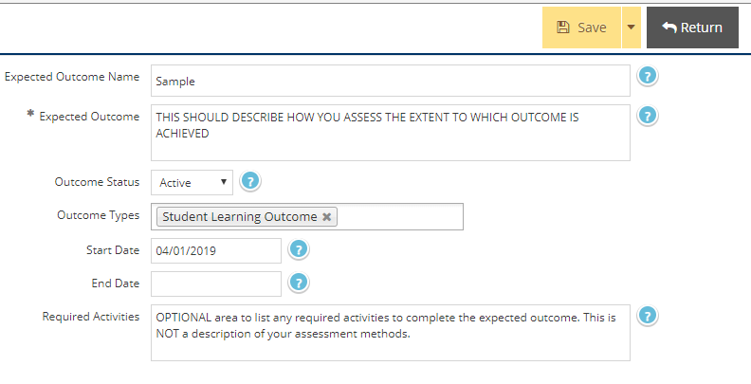
Editing Existing Outcomes
From the Sidebar under Plans and Results, select Plan, then select “edit” next to the outcome you need to change.
(#1) Edit the text and (#2) Save Changes and return.
#2
#1
Column 1 – Outcomes

Slide 46
How to update:
Column 2 – Assessment/Criterion

Slide 47
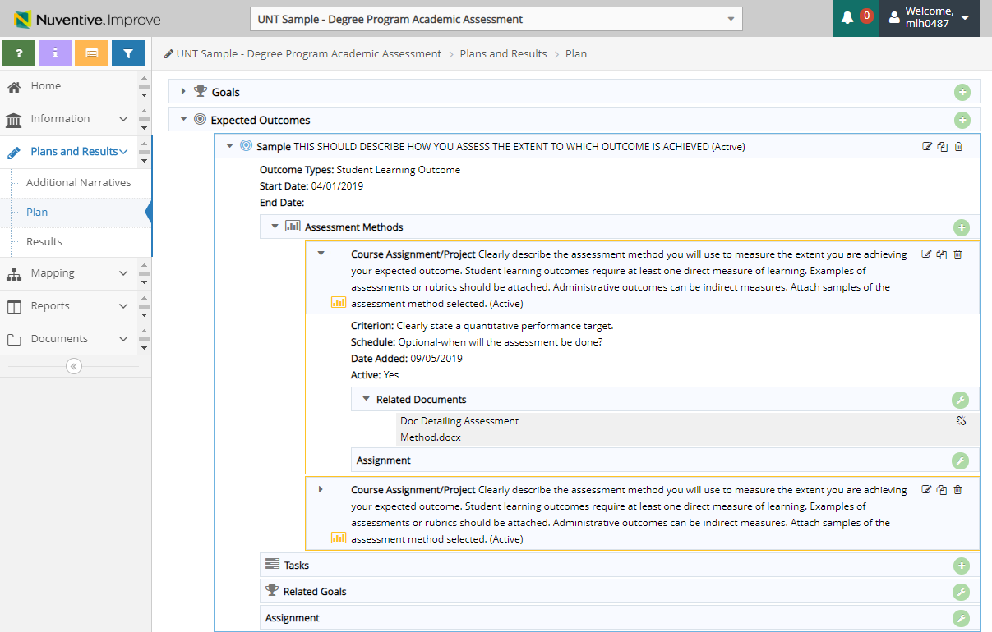
Assessment methods
Select: 1. Plans and Results; 2. Plan; 3. Expected Outcomes;
4. Select your outcome; 5. All active assessment methods will populate.
Use the “+“ to add a method.
Existing methods can be edited
Column 2 – Assessment/Criterion

Slide 48
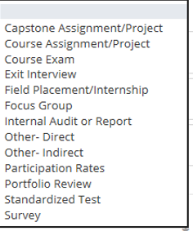
The method is automatically “active”. Uncheck the box if the method is not being used.
Click “Save Changes” when entry is complete.
Means of Assessment
1. Select a category for the method
2. Describe how the outcome will be assessed, including title of assessment instrument if applicable
3. State the Criterion- This is a brief statement that identifies the minimum percentage of students attaining a specific minimum performance level for success as measured on the assessment instrument for the SLO. (70% of students will score a minimum of 8 out of 10 points from the rubric) Do not use grades or means (averages). When setting your criterion, keep in mind things you could do to improve the results should you not meet it.
OPTIONAL: Enter the assessment schedule (will you assess annually, every long semester, etc.?)
Column 2 – Assessment/Criterion

Slide 49
Add documentation (grading rubric, instructions for the assignment, example test questions, etc.) to Means of Assessment: Part One
1. Plan and Results; 2. Plan; 3. Expected Outcomes; 4. Select Outcome; 5. Select Method; 6. Click on the wrench next related documents.
Column 2 – Assessment/Criterion

Slide 50
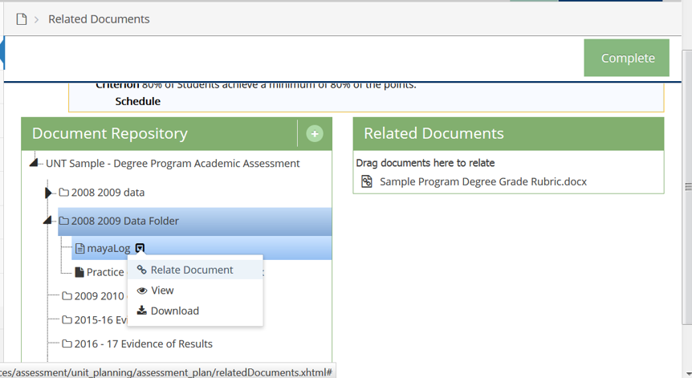
Add documentation to methods
If the document has already been uploaded, it should appear in your repository. Locate the document and Select “Relate Document”
.
*** PDF is the preferred document type***
If you have not uploaded the document before, use the ”+“ to add a new document.
Column 2 – Assessment/Criterion

Slide 51
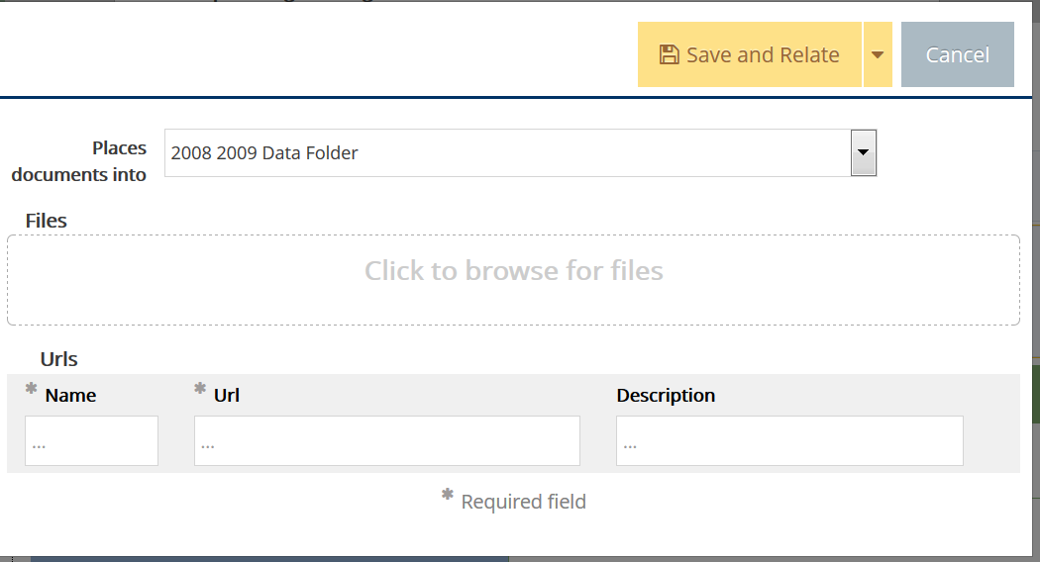
Add documentation to methods - Part Two
Select a folder. If General is the only option, select General
Browse for your documentation & include a short description
Save and relate the document
You can relate URLs if you have one (webpage) but we prefer PDFs of evidence to URLs as websites change often.
Column 2 – Assessment/Criterion

Slide 52
How to update Column 3 - Results & Evidence

Slide 53
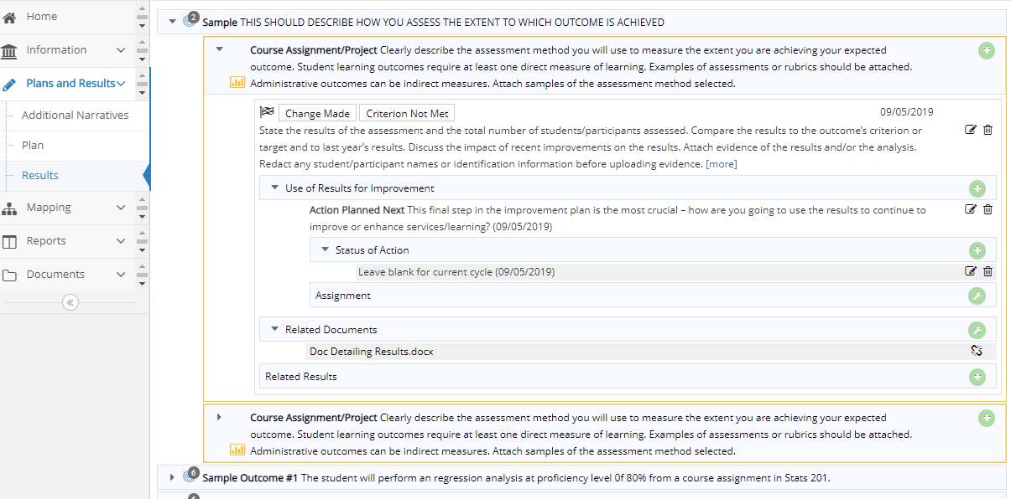
Results Entry
1. Plans and Results; 2. Results; 3. Select Outcome; 4. Select Method; 5. Add Result.
Column 3 – Results/Evidence

Slide 54
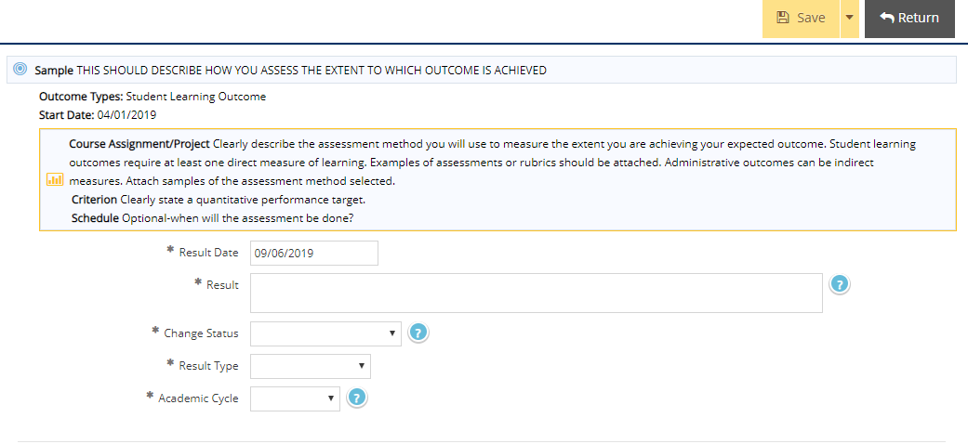
Results for Programs and Departments
Enter a description of the Results. For SLOs, include the number of students completing the assessment and the % that met your criterion for success. For AOs, include the total number of those assessed and the % that met your criterion for success.
Disaggregate Distance and Offsite data when appropriate
Select the Result Type based on the results- Was the Criterion Met, Not Met, or Inconclusive?
Column 3 – Results/Evidence

Slide 55
Sample result statement for a program with multiple modes of delivery:
“100 students were assessed (50 from main campus course sections, 25 from online sections, and 25 from offsite location XYZ). Overall, 75% of all students scored 80 or better on the assessment. The criterion (80% of students score 80 or better) was not met. 76% of main campus students met the criterion, 85% of offsite students met the criterion, and 70% of online students met the criterion. These results are 3% lower than last year’s overall results. We believe students at offsite location XYZ scored higher due to …[provide discussion points]…”
Column 4 Use of Results should then address improvement actions planned in the next academic year to increase learning outcomes for online and main campus students for this outcome.
Column 3 – Results/Evidence

Slide 56
Results
The Result Date is automatic. You can edit it if needed.
Select the Change Status based on the results.
Click on the Academic Cycle during which the results were collected.
Save Changes and Return.
Column 3 – Results/Evidence
Notes:
Select Change Made if changes have been made to the program because of the results. Select Change Recommended if, because of the results, you plan on changing the criterion, outcome, assessment method, etc.

Slide 57
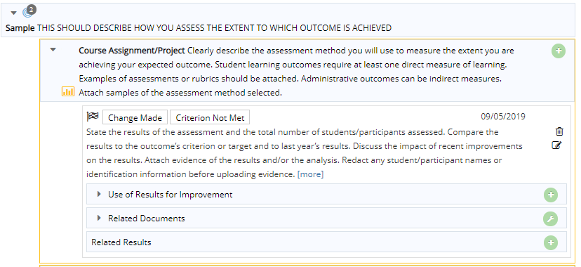
Adding additional information to Results
Recommended improvement plans and results evidence/analysis are added once results have been entered. Use the appropriate green button to add planned improvements or documentation of results.
Column 3 – Results/Evidence
Notes:
Select Change Made if changes have been made to the program because of the results. Select Change Recommended if, because of the results, you plan on changing the criterion, outcome, assessment method, etc.

Slide 58
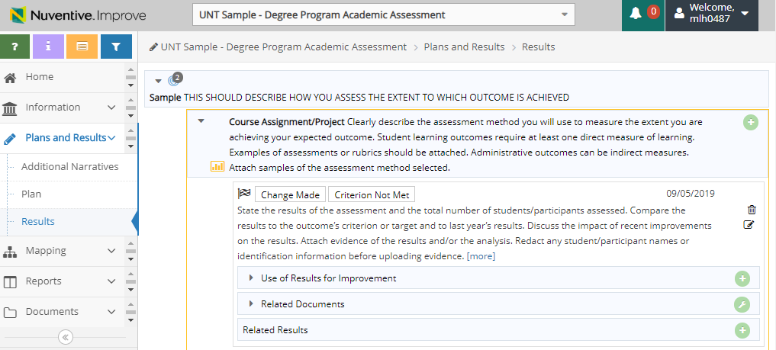
Add documentation to Results
Add Results documentation from the Results side tab.
*** PDF is the preferred document type***
Redact confidential or student ID data

Slide 59
Add documentation to Results
If the document has already been uploaded, it should appear in your repository. Locate the document and Select “Relate Document”
.
If you have not uploaded the document before, use the ”+“ to add a new document.
*** PDF is the preferred document type***
Column 3 – Results/Evidence

Slide 60
How to update Column 4 –
Use of Results
Improvement Actions Planned Next &
Status of Actions Implemented over the last 12 months

Slide 61
Closing the Loops
What can we modify to make positive gains for student attainment or administrative outcomes?
What will actually improve student learning or administrative efficacy?
Quality improvement actions
Excellence beyond the minimum expectations
How do you demonstrate continuous improvement?

Slide 62
Use of Results
This is the most important area. You have collected your results…
Documenting how program is “seeking improvement”
Now what? Or so what? Close the loops!
If criterion is met or exceeded for more than one cycle, is it set too low? How are you demonstrating that program is seeking improvement? (SACSCOC requirement)
If no improvement is needed after 2-3 cycles, choose a different objective to assess.
Avoid “Continue to monitor results” as a recommendation
Developing plans are not enough, evidence of implementation is needed in the Status of Action

Slide 63
Possible Improvement Actions based on Analysis
Curricular
Pedagogical
Academic support
Professional development
Improve assessment
Raise criterion
Administrative: Raise criterion, new outcome, change procedures/process to improve efficiency or services

Slide 64
Possible Improvement Actions (academic)
Create progressively more challenging projects, problems or standards of performance in your program
Do you use the same level of validity, reliability and empirical research in deciding curricular changes?
Can you improve future iterations of assessment?
If you use a high stakes test in your program, is your means of assessment valid?
Do you have interrater reliability in your assessment?

Slide 65
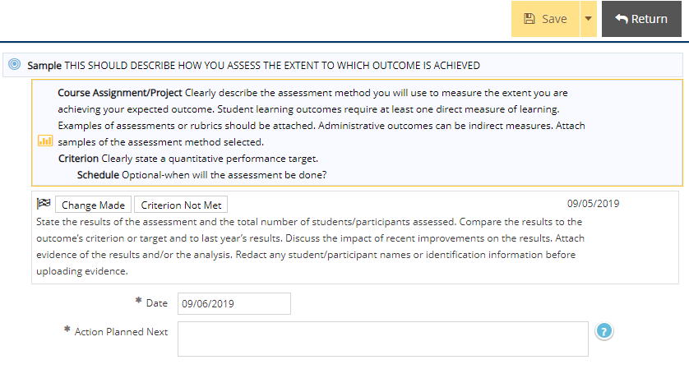
Use of Results for Improvement
This text box is used to explain what the unit plans on improving after analyzing results.
“Continue to monitor” is not acceptable except in first year of outcome.
Click “Save” and “Return” after entry.
Column 4 – Use of Results for Improvement
Notes:
There are 3 basic actions- Advancement, Maintenance, or Improvement. If your criterion was set low, you might want to recommend advancement, or “raising the bar”. If the results met the criterion, but your sample was too small or there were errors in data collection, you can use this area to explain what you are doing to correct the problem.

Slide 66
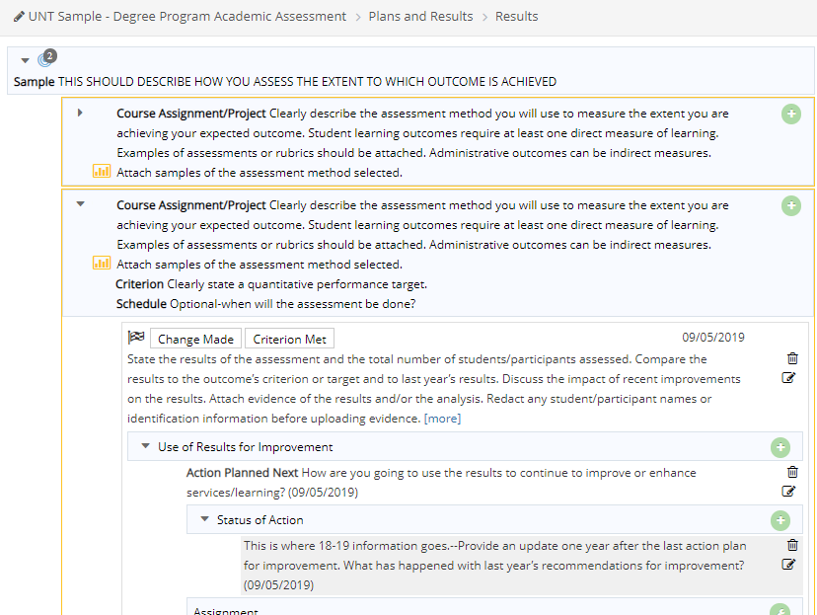
Status of Action on last cycle’s planned improvements
Add a status update (follow-up) to actions planned during the last cycle.
If an improvement was planned after 2018-19, a status update should be entered now for 2019-20 end of year reporting.
Column 4 – Use of Results for Improvement

Slide 67
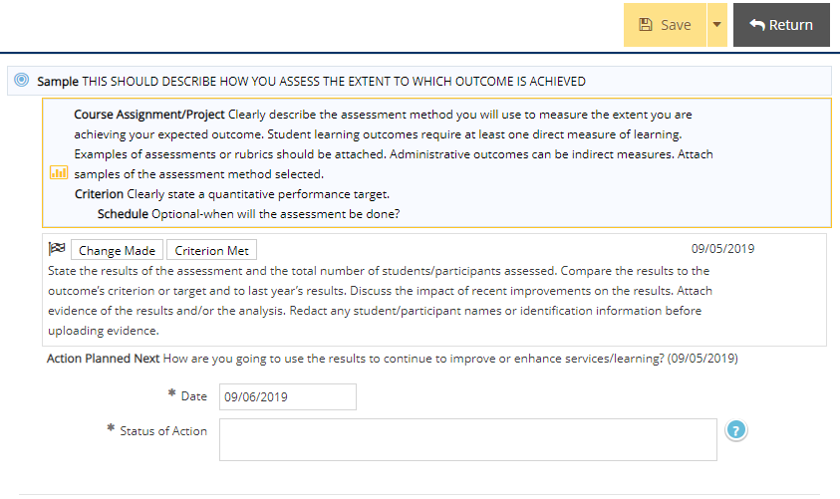
Adding a Status of Action
Did the program/office implement the recommendation? Did it have any effect on the outcome? The only time you do not need to do this is if the recommendation was to close the outcome and assess a new outcome.
Column 4 – Use of Results for Improvement

Slide 68
Things to remember:
IE is about improving or enhancing- not reporting.
IE is not about proving students can perform at a specific, minimal level year after year
Always run a 4-Column Report after changes & save copy
Never delete or overwrite existing outcomes, methods, or results (showing a mature, ongoing process is good)
Always address your prior improvement plans (status update).
It is ok to not meet your criterion- Just include your plans (actions to take) in the “next action planned” section
The deadline for Academic and Administrative plans is October 15th.

Slide 69
Column 1
Column 2
Column 3
Column 4
So how does a 4-column report demonstrate IE?
Institutional Effectiveness (IE)
Institutional Effectiveness is the systematic and ongoing process of identifying expected outcomes, assessing the extent to which the outcomes are achieved, and providing evidence of seeking improvement based on analysis of the results.

Slide 70
Curriculum Mapping Tool
Map your program’s assessment
Benefits: curricular decisions, program review, program accreditation, IE improvement planning
What is it?
Aligns goals and program outcomes
Documents what is taught & sequence of curriculum
Foundation for assessment planning and IE
Visual tool to show relationship between courses and program learning outcomes
Scaffolded view of learning (introduction, development and mastery of concepts)
Contact UA to provide resources and support

Slide 71
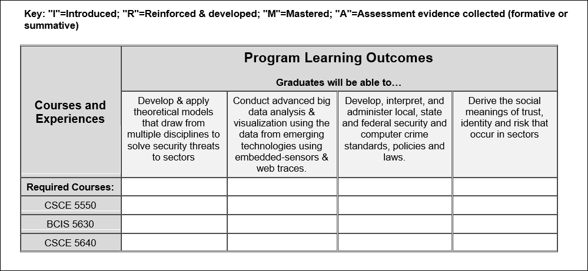

Slide 72
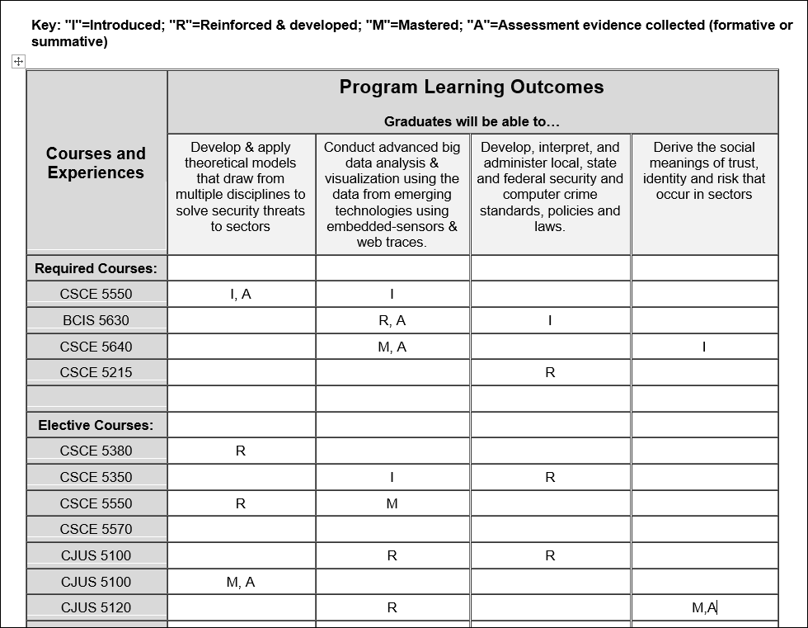
Never assessed or mastered
No development

Slide 73
Questions and Wrap Up
Office of University Accreditation
University of North Texas
Hurley Administration Building Room 135
improve@unt.edu
Elizabeth Vogt
University Accreditation
Elizabeth.Vogt@UNT.edu
940-565-5288
Kim Faris
University Accreditation
Kimberly.Faris@UNT.edu
940-565-4584
Additional support:
Ronda Bewley, Tazh Brown & Zenaida Simpson Pomare

